Slide 1
Review CAR 133911523

Slide 2
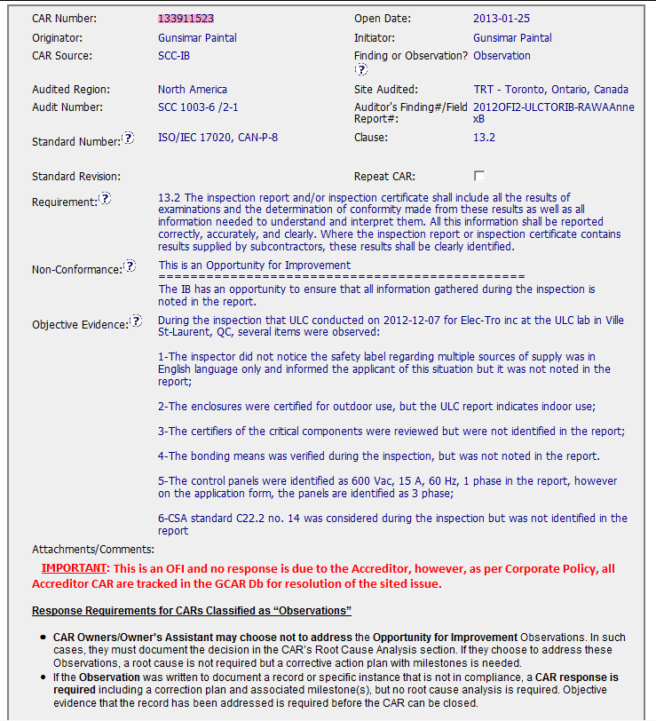
Classed as an Observation
Recorded as an Opportunity for improvement
Multiple issues with the report:
Scope - Was this just the one sub standard report ?

Slide 3
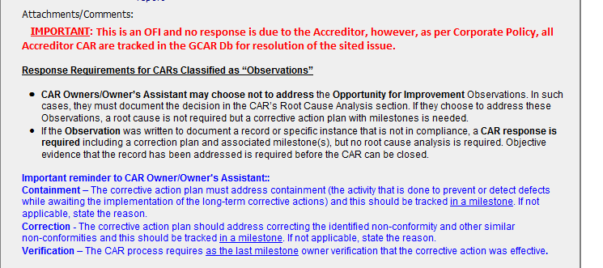
Observation and Finding
Guidance included
- Source of the confusion ?

Slide 4
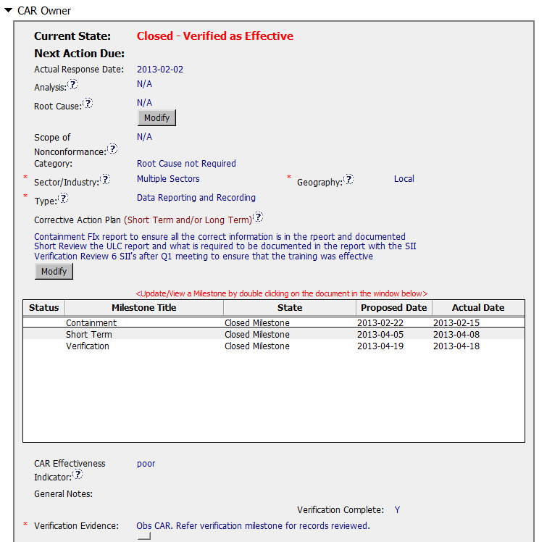
Analysis etc. completed as an Observation
Addressed as Finding in the corrective action
CAR effectiveness Indicator as POOR?
Also if this was to be a Finding for the OFI shouldn’t more records have been reviewed?

Slide 5
